Slide 1
Pi and Python Introductory Course
4 Feb 2023

Slide 2
What’s in your kit
Raspberry Pi + power cable
GPIO pin diagram
Devices (LEDs, buzzers, motion sensor, push buttons, resistors)
Wires
Breadboard
Laptop
Course notes (please do not write on it)

Slide 3
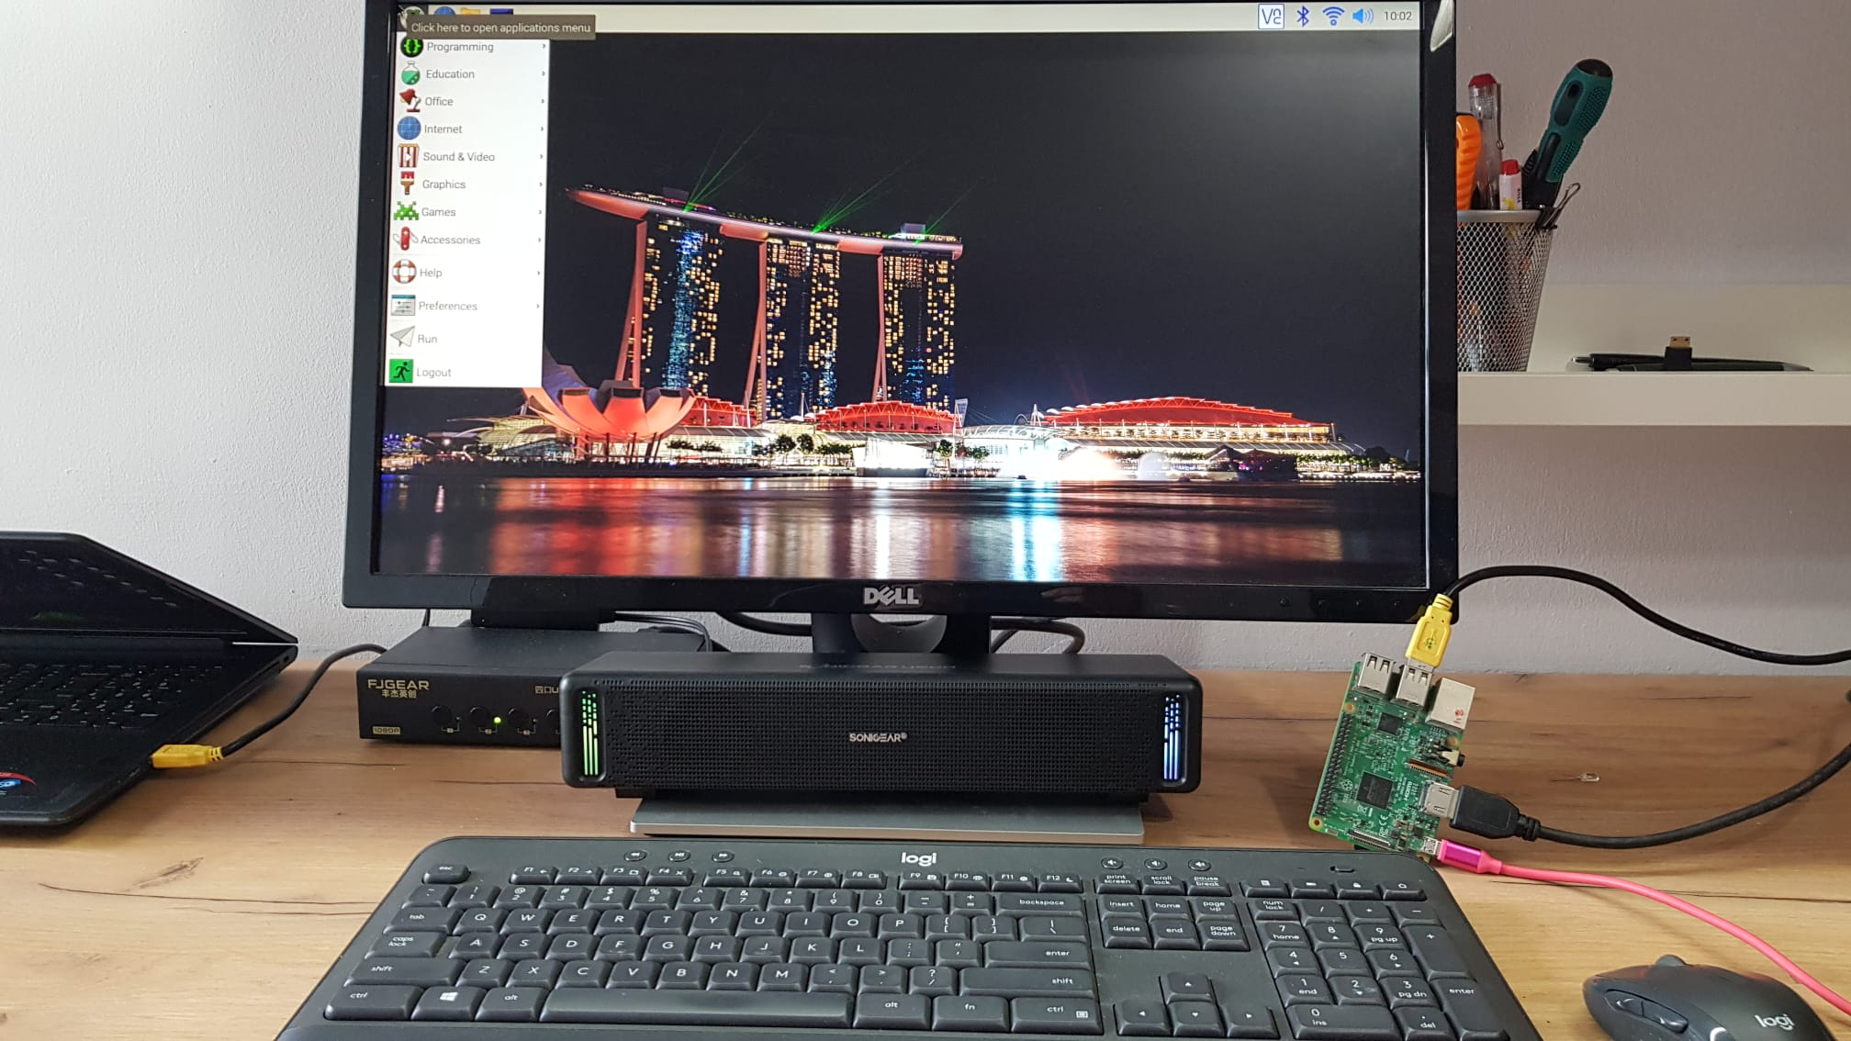
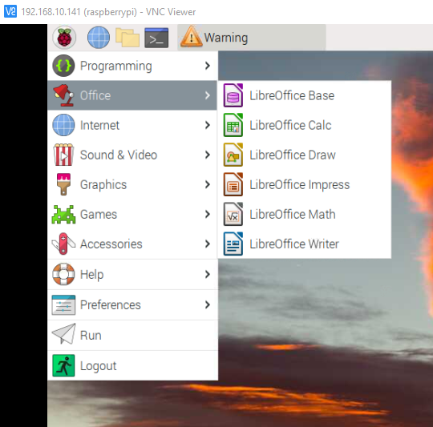
What is a Raspberry Pi
A low-cost single board computer
Credit card-sized but packs a punch
Operates in the same way as a conventional PC/laptop

Slide 4
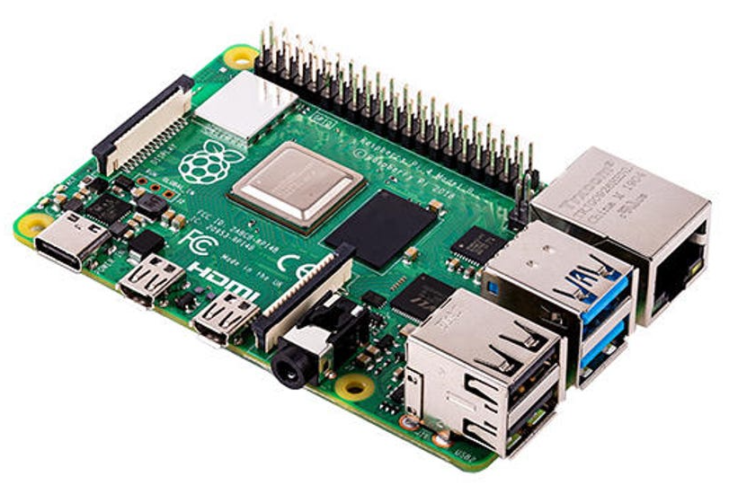
GPIO pins
With these pins the Pi can interact with and control things in the real world

Slide 5
Things in the real world
Sensors and Controls
Sight, sound, sense, light
Data collection
Data visualization
Two Types of Sensor/Control
Input (Data Collection)
Output (Data Dissemination)

Slide 6
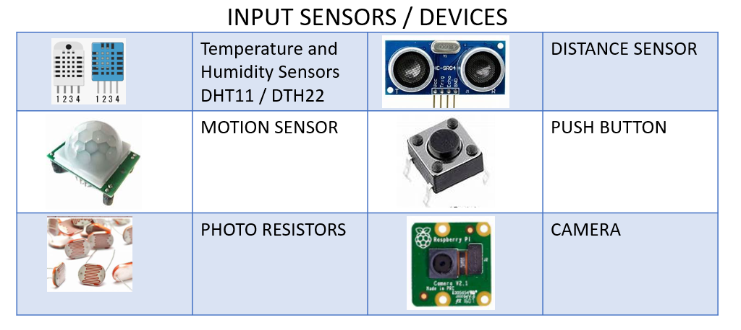
Input devices

Slide 7
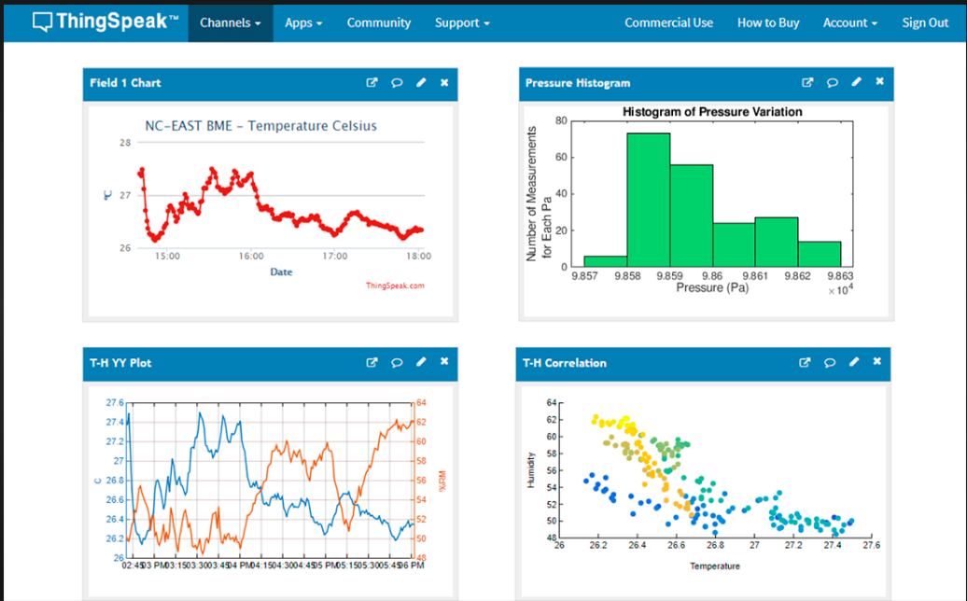
Data collection & visualisation

Slide 8
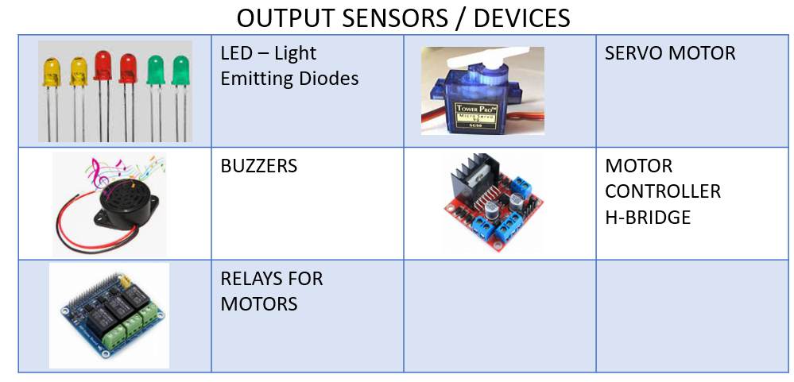
Output devices

Slide 9
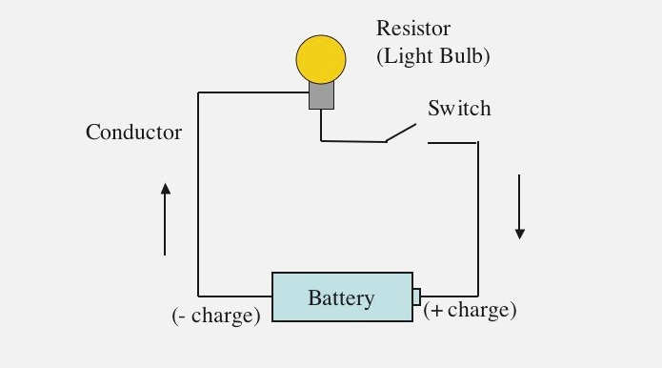
Electrical / Electronic circuits
What is a circuit?
Notes:
You need three things for an electrical circuit
Energy source (battery)
Device that uses energy (LED bulb)
Conductor (wires)

Slide 10
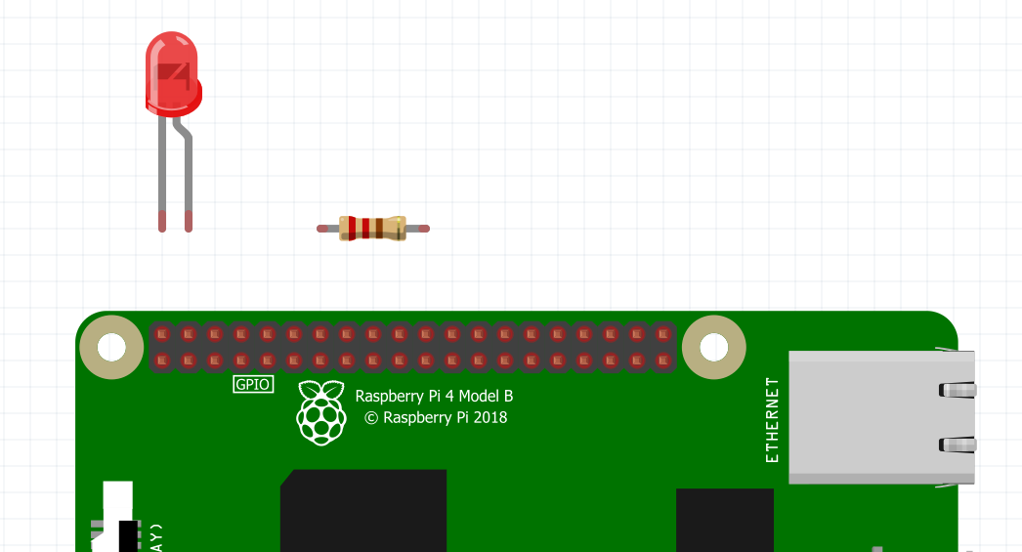
Instead of a manual switch
you will learn how to use Python codes to control the circuit

Slide 11
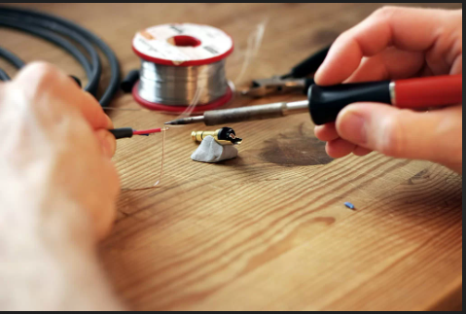
Wiring up a Circuit

Slide 12
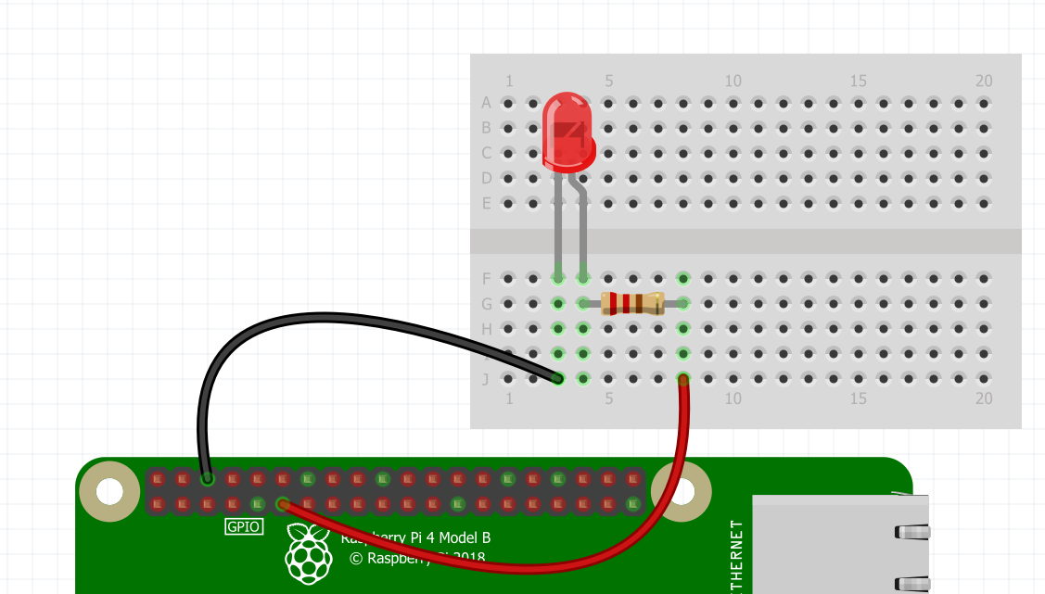
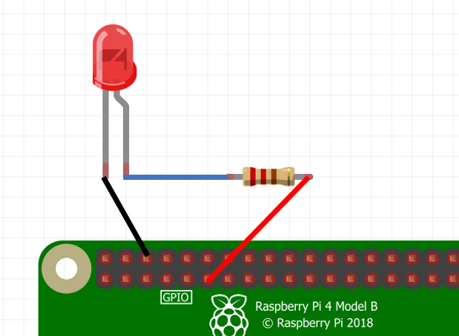
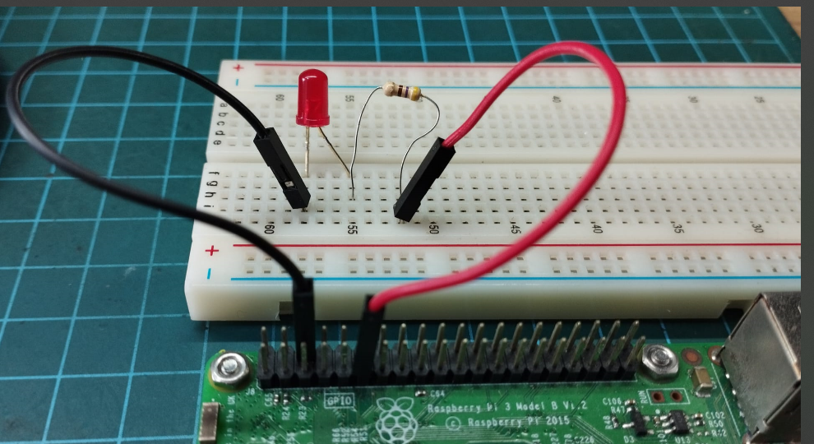
BREADBOARD
GROUND
GPIO 17

Slide 13
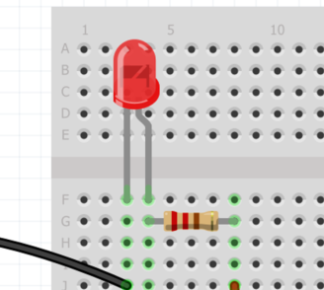
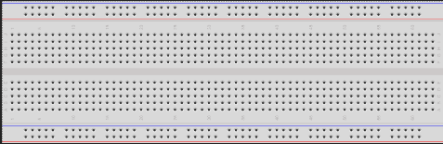
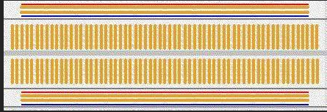
THE BREADBOARD
POWER RAIL
GROUND RAIL
Soldering an LED to a resistor
Connections inside the Breadboard

Slide 14
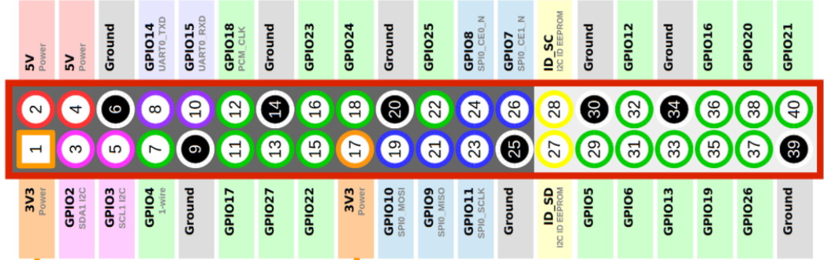
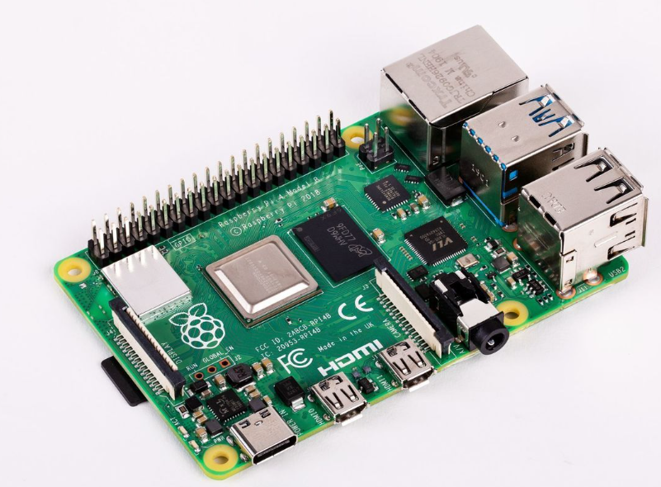
The GPIO PINS (General Input Output Pins)
1
2
3
4
5
6
7
8
9
10
11
12
13
14
15
16
17
18
19
20
BCM
BOARD
BCM
20
19
18
17
16
15
14
13
12
11
10
9
8
7
6
5
4
3
2
1
GPIO 17
There are two Pin Addressing method
BCM – Broadcom [Use numbering in Rectangular Block]
BOARD – [No in Circles]
IN THIS COURSE WE USE THE BCM PIN NUMBERS

Slide 15
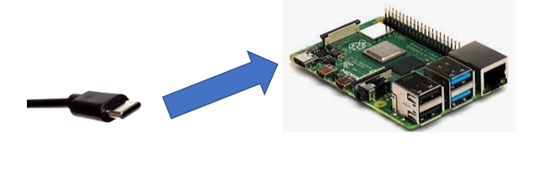
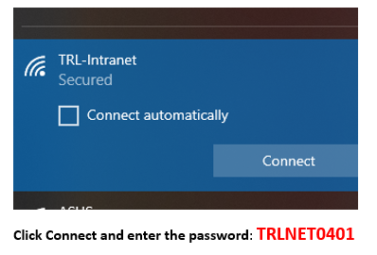
Powering up the Pi
1. Connect Pi to power supply using power cable (USB Type-C)
2. Connect laptop to TRL-Intranet
Password: TRLNET0401
Note: There is no internet

Slide 16
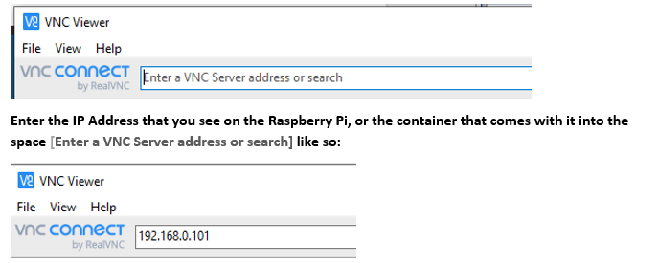
Powering up the Pi
3. Launch VNC Viewer program on the laptop
4. Key in IP address (found on container/ Raspberry Pi)

Slide 17
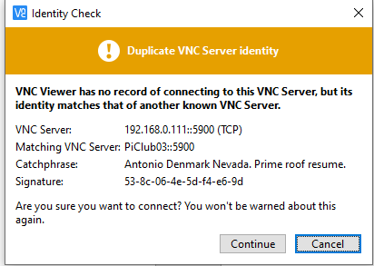
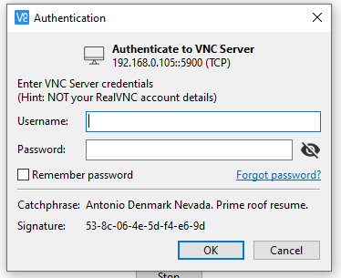
Powering up the Pi
5. Key in User ID and Password
pi
raspberry

Slide 18
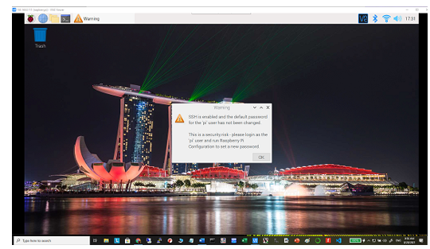
Powering up the Pi
6. Log in successful
Notes:
This type of remote connection to the raspberry pi is known as a headless connection

